Slide 1
Identifying neighborhood to open a restaurant
In which neighborhood in North York a restaurant can be opened

Slide 2
.
To suggest her the best neighborhood, below are the few things that I considered along with competition.
Accessibility If restaurant near residential or student living places, it provides better commute.
Visibility If it is in a place where there are few other restaurants, shopping malls, grocery stores it gives more visibility
Crime rate High crime rates can make potential customers uncomfortable. Therefore if restaurant is in a busy neighborhood surrounded by few other malls or restaurants, less crime rate more customers.

Slide 3
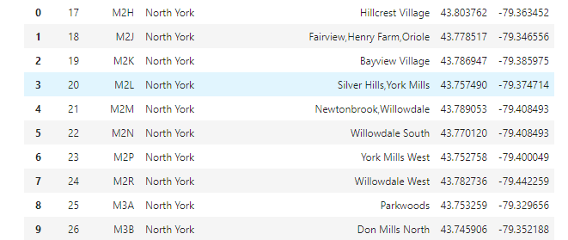
.
Data we need:
latitude and longitude numbers of that borough(43.7708175, -79.4132998)I will need data about different venues in different neighborhoods of that specific borough. In order to gain that information I will use "Foursquare" locational information. (52 venues were returned by Foursquare)

Slide 4
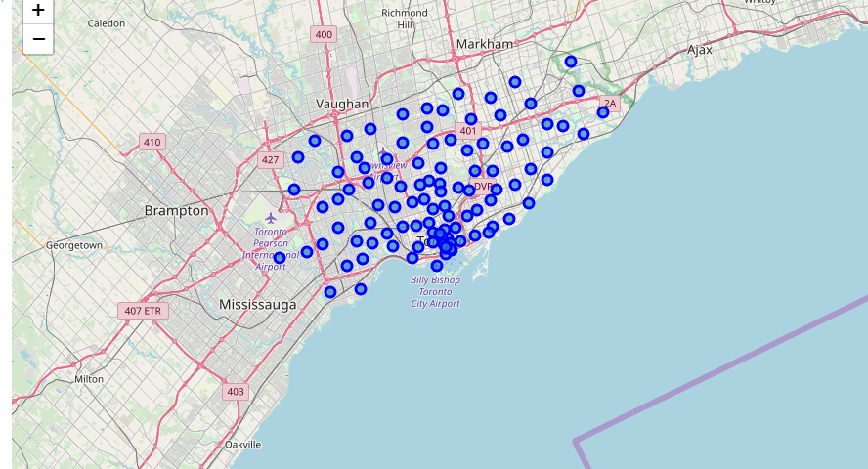
Identifying postal code in North York

Slide 5
Connecting to Foursquare and Retrieving Locational Data for Each Venue in Every Neighborhood
After finding the list of neighborhoods, we then connect to the Foursquare API to gather information about venues inside each and every neighborhood. For each neighborhood, we have chosen the radius to be 1000 meter. It means that we have asked Foursquare to find venues that are at most 1000 meter far from the center of the neighborhood.

Slide 6
.
Processing the Retrieved Data and Creating a Data Frame for All the Venues inside the North York
When the data is completely gathered, we will perform processing on that raw data to find our desirable features for each venue. Our main feature is the category of that venue. After this stage, the column "Venue's Category" will be One-hot encoded and different venues will have different feature-columns.

Slide 7
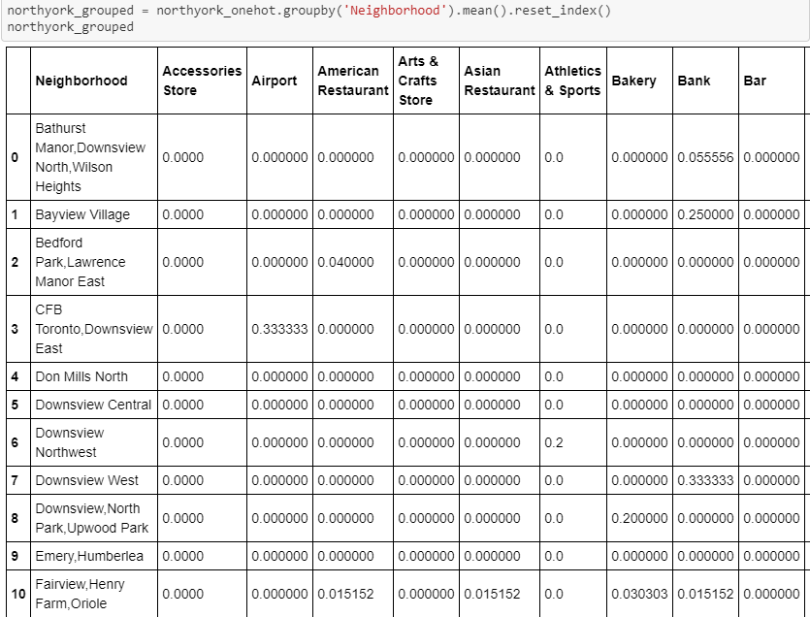
.
Onehot encoding.

Slide 8
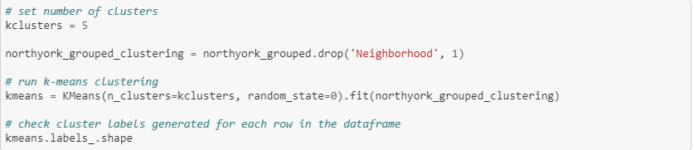
.
Applying one of Machine Learning Techniques (K-Means Clustering)
Here we cluster neighborhoods via K-means clustering method. We think that 5 clusters is enough and can cover the complexity of our problem. After clustering we will update our dataset and create a column representing the group for each neighborhood.

Slide 9
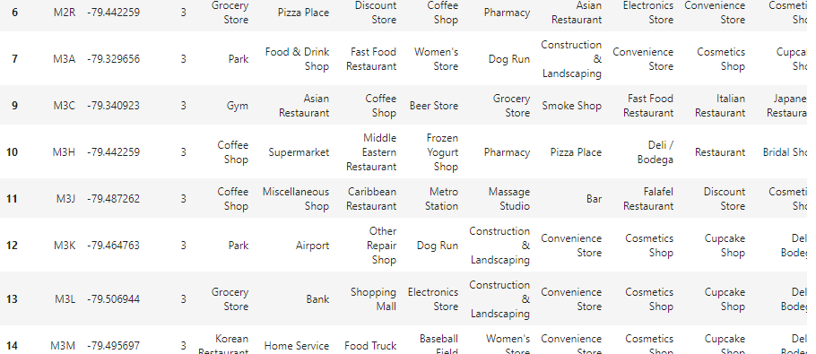
Results: Here for North York, I have used 5 clusters(k=5 ie 0,1,2,3,4). If we look at k=3 cluster, M3A zip code has park, decent restaurants and also shopping stores. It satisfies few of above mentioned criteria like accessibility, visibility and less crime rate. This algorithm although is pretty straightforward yet is strongly powerful. Results: Based on this analysis, the best recommended neighborhood will be: 'Neighborhood': 'Parkwoods', 'Postal Code': 'M3A', 'Neighborhood Latitude': 43.753259, 'Neighborhood Longitude': -79.329656

Slide 10

.

